Slide 1
Basic Blocks, Flow Graphs

Slide 2
Flow Graphs
A flow graph is a graphical depiction of a sequence of instructions
A flow graph can be defined at the intermediate code level or target code level

Slide 3
Example
MOV 0,R0 MOV n,R1 JMP L2 L1: MUL 2,R0 SUB 1,R1 L2: JMPNZ R1,L1
MOV 1,R0 MOV n,R1 JMP L2 L1: MUL 2,R0 SUB 1,R1 L2: JMPNZ R1,L1

Slide 4
Basic Blocks
A basic block is a sequence of consecutive statements in which flow of control enters at the beginning and leaves at the end without halt or possibility of branching except at the end (with natural flow or a branch instruction)
The basic blocks become the nodes of a flow graph, whose edges indicate which blocks can follow which other blocks.

Slide 5
Basic blocks and flow graphs
Graph representation of 3-address statement – flow graph
Nodes in the graph – Computations
Edges in the graph – Flow of control
Useful for optimization, register allocation

Slide 6
Basic Blocks & Control Flow Graph
A control flow graph (CFG) is a directed graph with basic blocks B_{i} as vertices and with edges B_{i}→B_{j} iff B_{j} can be executed immediately after B_{i}

Slide 7
Partition Algorithm for Basic Blocks
Input: A sequence of three-address statements
Output: A list of the basic blocks for that sequence in which each instruction is assigned to exactly one basic block.
Determine the set of leaders, the first statements if basic blocks
The first statement is the leader
Any statement that is the target of a conditional or unconditional jump is a leader
Any statement that immediately follows a conditional or unconditional jump is a leader
For each leader, its basic block consist of the leader and all statements up to but not including the next leader or the end of the program

Slide 8

Example
MOV 1,R0 MOV n,R1 JMP L2
MOV 1,R0 MOV n,R1 JMP L2 L1: MUL 2,R0 SUB 1,R1 L2: JMPNZ R1,L1
L1: MUL 2,R0 SUB 1,R1
L2: JMPNZ R1,L1

Slide 9
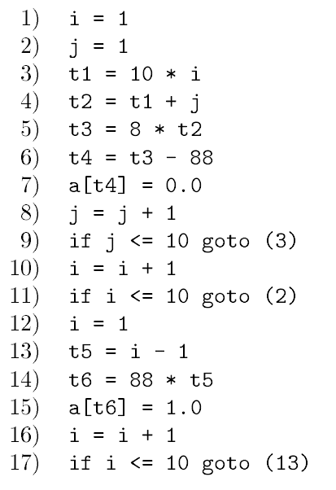
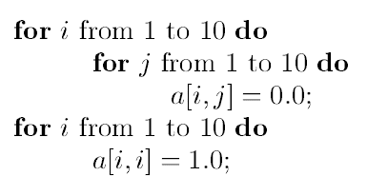

Slide 10
Successor and Predecessor Blocks
Suppose the flow graph has an edge B₁→B₂
B₁ is a predecessor of B₂ and B₂ is a successor of B₁
MOV 1,R0 MOV n,R1 JMP L2
L1: MUL 2,R0 SUB 1,R1
L2: JMPNZ R1,L1

Slide 11
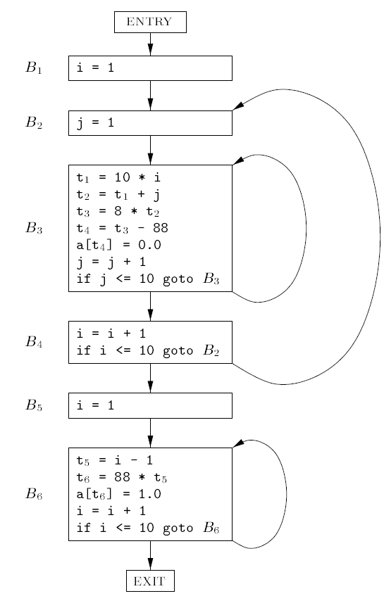
Notes:
B2, B3, {B2,B3,B4}

Slide 12
Example
Begin
prod := 0
i := 1;
do begin
prod : = prod + a[i] * b[i];
i = i +1;
end
while i < = 20
end
prod := 0
i := 1
t1 := 4 * i
t2 := a[t1]
t3 := 4 * i
t4 := b [t3]
t5 := t2 *t4
t6 := prod + t5
prod := t6
t7 := i+1
i := t7
If i <= 20 goto (3)

Slide 13
Identifying leaders
(1) is the beginning – hence leader
(3) is the target of a jump – hence leader
Lines (1) and (2) is a basic block
Statement following (12) is a leader
Statements (3) to (12) is another basic block

Slide 14
Control flow graph
B1
prod := 0
i := 1
B2
t1 := 4 * I
t2 := a[t1]
t3 := 4 * I
t4 := b [t3]
t5 := t2 *t4
t6 := prod + t5
prod := t6
t7 := i+1
i := t7
If i <= 20 goto (3)
B1 is the predecessor of B2 and B2 is the successor of B1

Slide 15
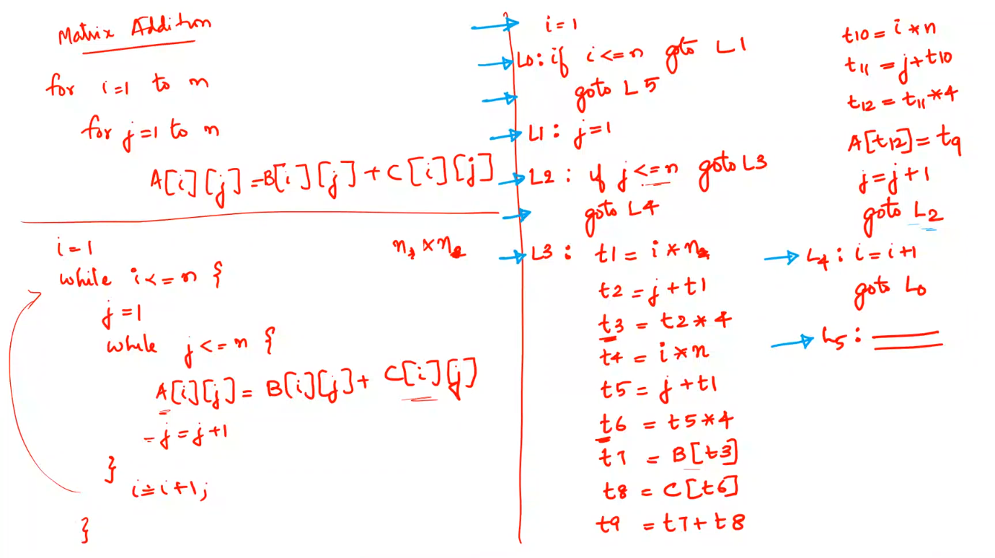

Slide 16
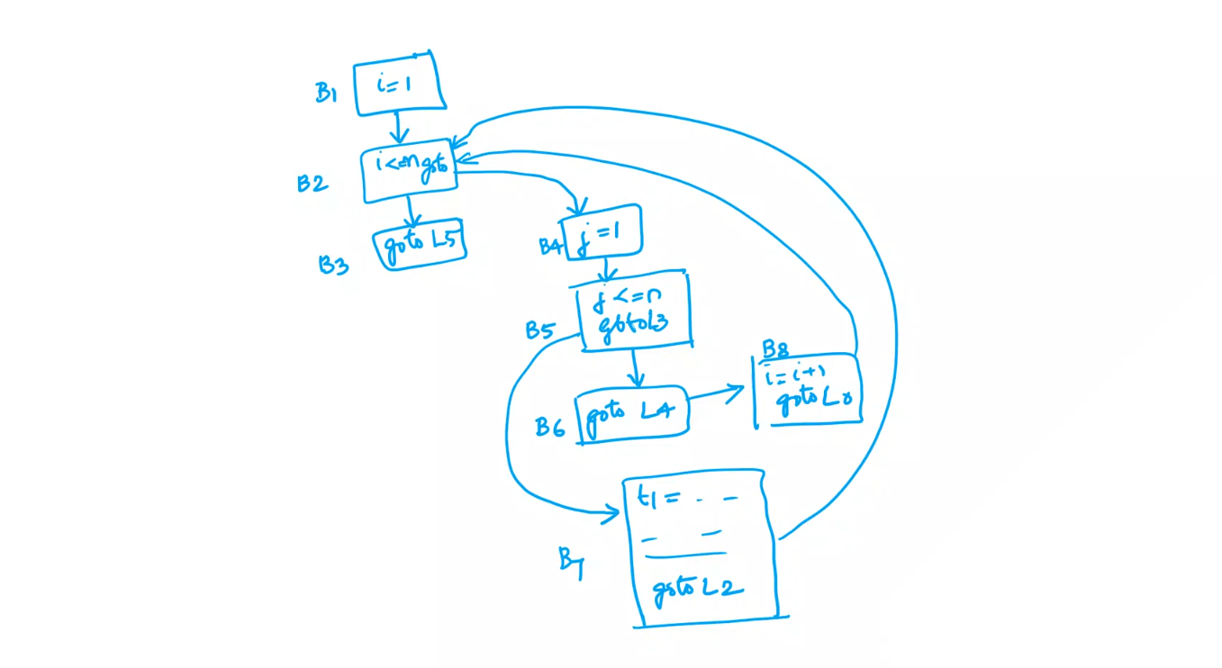

Slide 17
Loops
A loop is a collection of basic blocks, such that
All blocks in the collection are strongly connected – any node to any other there is a path of length one or more within the loop
The collection has a unique entry, and the only way to reach a block in the loop is through the entry

Slide 18
Outer & Inner loops
Loops not containing any other loop is Inner loop
Loops that has one or more inner loops is outer loop

Slide 19
Loops (Example)
B1:
MOV 1,R0 MOV n,R1 JMP L2
Strongly connected components:
SCC={{B2,B3}, {B4} }
B2:
L1: MUL 2,R0 SUB 1,R1
B3:
L2: JMPNZ R1,L1
Entries:
B3, B4
B4:
L3: ADD 2,R2 SUB 1,R0 JMPNZ R0,L3

Slide 20
Transformations on Basic blocks
Basic block computes set of expressions
Values of the variables outside the block is decided by the computation inside the block
Two basic blocks are equivalent if they compute the same set of expressions
Notes:
What possibilities are there in basic blocks in terms of transformations.
Two types of transformations – structure preserving and algebraic transformations

Slide 21
Equivalence of Basic Blocks
Two basic blocks are equivalent if they compute the same set of expressions
b := 0 t1 := a + b t2 := c * t1 a := t2
a := c * a b := 0
a := c*a b := 0
a := c*a b := 0

Slide 22
Transformation on Basic Blocks
A code-improving transformation is a code optimization to improve speed or reduce code size
Global transformations are performed across basic blocks
Local transformations are only performed on single basic blocks
Transformations must be safe and preserve the meaning of the code
A local transformation is safe if the transformed basic block is guaranteed to be equivalent to its original form

Slide 23
Transformations on Basic blocks
Structure-Preserving Transformation
Syntactic structure of the statements in the basic blocks are not altered
Algebraic Transformation
Mathematical identity based transformation and thus altering the syntactic structure

Slide 24
Transformations on Basic blocks
Structure-Preserving Transformation
Common Sub-expression Elimination
Dead-code elimination
Renaming of temporary variables
Interchange of two independent adjacent statements

Slide 25
Common-Subexpression Elimination
Remove redundant computations
a := b + c b := a - d c := b + c d := a - d
a := b + c b := a - d c := b + c d := b
t1 := b * c t2 := a - t1 t3 := b * c t4 := t2 + t3
t1 := b * c t2 := a - t1 t4 := t2 + t1

Slide 26
Dead Code Elimination
Remove unused statements
b := a + 1 a := b + c …
b := a + 1 …
Assuming a is dead (not used)
if true goto L2
b := x + y …
Remove unreachable code

Slide 27
Renaming Temporary Variables
Temporary variables that are dead at the end of a block can be safely renamed
t1 := b + c t2 := a - t1 t1 := t1 * d d := t2 + t1
t1 := b + c t2 := a - t1 t3 := t1 * d d := t2 + t3

Slide 28
Interchange of Statements
Independent statements can be reordered
In this example, neither t1 or d is t2, nor a or t1 is t3
t1 := b + c t2 := a - t1 t3 := t1 * d d := t2 + t3
t1 := b + c t3 := t1 * d t2 := a - t1 d := t2 + t3

Slide 29
Algebraic Transformations
Change arithmetic operations to transform blocks to algebraic equivalent forms
t1 := a - a t2 := b + t1 t3 := 2 * t2
x := y ** 2
t1 := 0 t2 := b t3 := t2 << 1
x := y * y

Slide 30
Summary
Converting code to Basic blocks
Possible transformations in basic blocks

